Slide 1
System Flow Cohort..
Session 3.
Please rename yourself in Zoom.. to include your community..
. August 17, 2021..

Slide 2
This meeting will be recorded.
Smile into the camera :)

Slide 3
In the chat tell us...
What was your very first job?

Slide 4
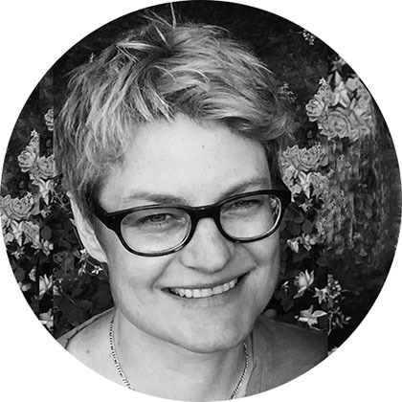
Your Team of Coaches
Habiba Rotter
Intervention Manager, Design And Delivery
Erin Healy
Strategy Lead, Large Scale Change

Slide 5
Today we will
Talk about integrating system flow work into case conferencing
Learn about the buckets system and how it can help you house clients faster
Set you up to assign ‘bucket leads’
Notes:
Right now, tap into your most focused, nerdy, number loving brain!

Slide 6
If you haven’t calculated August data, take a few minutes to do it now
Notes:
HR

Slide 7
What’s the most recent change in your data? What do you attribute it to?
Chat or Unmute
Notes:
HR

Slide 8
NoCo met and exceeded their aim!!!
Long Stayers 33% → 10%
Notes:
Minneapolis team unmute, what got you there?

Slide 9
Minneapolis met and exceeded their aim!!!
Notes:
Minneapolis team unmute, what got you there?

Slide 10
Flex Funds! .
Chat or Unmute
Name one thing you are excited to do/try with these funds!
Nashville/Davidson County CoC
Greater Kansas City Coalition to End Homelessness
Middlesex County CoC/Coming Home
Tennessee Valley
Northern Colorado CoC
Winston-Salem/Forsyth County CoC
Yamhill County
North Central Florida

Slide 11
We heard from you: Case conferencing can be the place to house long stayers

Slide 12
Breakouts
How are you integrating system flow work into case conferencing? Consider:
Creating shared objectives
Agenda
Measuring progress

Slide 13
Triad breakout.
Rooms will pop on your screen to join, hover over the right side of the room name and you will get the option to join
Lemonade
Honolulu
Minneapolis
Tucson
Grapes
Lake Co
Madison
Fairfax
Lavender
Nashville Sacramento - Veteran
Kansas City
Apple
Tennessee Valley
Middlesex
Northern Colorado
Mango
Springfield - Chronic
St Johns
Guilford Co.
Sacramento PRK
Avocado
Mid-Willamette
Winston-Salem
Springfield - Veteran
Blueberry
Yamhill - Vet
Yamhill - Chronic
Placer Co
Blackberry
Fresno
North Central Florida
Santa Cruz
Notes:
8 breakouts for 20 minutes
Copy and paste questions into the chat

Slide 14
Quick debrief

Slide 15
Buckets System
Notes:
HR

Slide 16
Remember the buckets?
Notes:
HR

Slide 17
One way to look at our housing process.
ASSESS
MATCH
NAVIGATE
IDENTIFICATION
MOVE IN
To advance clients to the next bucket:
Complete assessment
To advance clients to the next bucket:
Match to resource, program, or housing plan
To advance clients to the next bucket:
Locate housing and get moved in
Notes:
HR

Slide 18
How Bucket System Helps.
Gives aggregate picture vs individual; can reveal obscured systemic issues
Set goals for progression from one to another, and Celebrate
Divide and conquer; test improvement ideas for each transition point
Opportunity to distribute leadership of improvement efforts (empower front-line staff)
Notes:
HR

Slide 19
How we’ll generate actions for each client.
SYSTEM BARRIER
What barrier is preventing them from moving to the next part of the housing process?
FOLLOW-UP
Did we do the last action step? If no, what will we do now? If yes, what can we learn from it?
ACTION STEP
What action will we take this week to move them along?
TARGET MOVE-IN DATE
Given what we know, when do we predict they’ll move into permanent housing?
Notes:
HR

Slide 20
How to Implement for long stayers
By Name List
26 Long Term Stayers
Bucket Lead
Bucket lead
Bucket lead
ASSESS
MATCH
NAVIGATE
To advance clients to the next bucket:
Complete assessment
To advance clients to the next bucket:
Match to resource, program, or housing plan
To advance clients to the next bucket:
Locate housing and get moved in
IDENTIFY
MOVE IN
5 clients
8 clients
13 clients
Notes:
HR

Slide 21
What are your biggest and smallest buckets?.
ASSESS
?
MATCH
?
NAVIGATE
?
IDENTIFICATION
MOVE IN
Track results and see how close you were!
Notes:
HR

Slide 22
Bucket Leads.
Notes:
EH

Slide 23
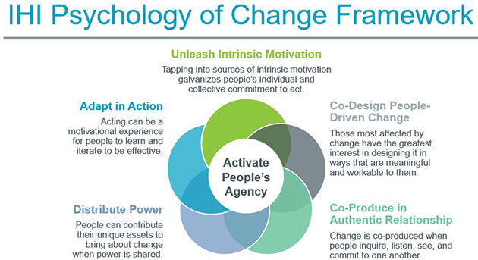
Creating a Culture of Improvement

Slide 24
Unleash Intrinsic Motivation
Creating the conditions for many people to carry forward a shared cause on the basis of inherent value that one experiences in the activity*; and not because of carrot-stick or fear (extrinsic).
Manager/Supervisor: | Potential Bucket Lead for ASSESS: | Motivating Principle
What matters the most to you in this work? | That I can create trust with my outreach clients, to help them get on the path to housing | tap into emotional resources, motivation
Do you have ideas you want to try, to make that happen? | Yes, several. | Engage, invite creativity
I’d love for you to lead a team to run a short term test of one of your ideas |  | empower staff to take ownership
 | That’d be great - - but what if the ideas don’t work? Is my job at stake?
No, quite the opposite. Your leadership is valued - and it’s just as important to learn what doesn't work |  | psychological safety
 | Okay! I’m excited because this could help the whole team -- let’s get started! | shared values, urgency

Slide 25
Co-design People-Driven Change
Design with, not for
Include the people who are experiencing the problem and/or implementing the solution
Includes LTS and the staff working each day to get them into housing
Start small
Be transparent
Example of a People-Driven Aim Statement
We, [the BFZ improvement Team] are co-designing with [frontline outreach leads] to [increase the number of LTS moving from ASSESS to MATCH] by [X%] within [X days] by [implementing practices to increase clients’ trust] in order to [increase Assessment completion rate].

Slide 26
Choosing Bucket Leads
Consider:
Someone who attends case conferencing meetings and identify places for improvement
Do they work directly with the processes/barriers within the specific Bucket?
Do you see leadership potential?
Breakouts:
Who are you thinking about for Bucket leads? Do you have a stand-out outreach worker, case-manager in mind (creative thinker, enthusiastic)?
In the context of your day to day work, how can you tap into intrinsic motivation?
What factors could be barriers (e.g., workload; workplace culture) - and how can you solve for them?
How will you define success?

Slide 27
Triad breakout.
Rooms will pop on your screen to join, hover over the right side of the room name and you will get the option to join
Lemonade
Honolulu
Minneapolis
Tucson
Grapes
Lake Co
Madison
Fairfax
Lavender
Nashville Sacramento - Veteran
Kansas City
Apple
Tennessee Valley
Middlesex
Northern Colorado
Mango
Springfield - Chronic
St Johns
Guilford Co.
Sacramento PRK
Avocado
Mid-Willamette
Winston-Salem
Springfield - Veteran
Blueberry
Yamhill - Vet
Yamhill - Chronic
Placer Co
Blackberry
Fresno
North Central Florida
Santa Cruz
Notes:
8 breakouts for 20 minutes
Copy and paste questions into the chat

Slide 28
Closing.
Notes:
EH

Slide 29
In August, we invite you to
Map how many long stayers you have in each bucket
Talk to your team and invite a frontline staff member to become a bucket lead
Set up a meeting to talk about strategies to move each set of long stayers to the next bucket

Slide 30
Get ready to share out!
We will send you a slide deck to fill out as you do your bucket work. On September’s call, we will present them out to each other.

Slide 31
Until then,.
Keep testing changes
Calculate September data
Report back on bucket lead meetings
THANKS FOR COMING! We’re here to help. Email Habiba anytime: hrotter@community.solutions
Notes:
ET

