Slide 1
System Flow Cohort.
September 2021.
Please rename yourself in Zoom.. to include your community..

Slide 2
This meeting is being recorded.
Smile into the camera :)

Slide 3
In the System Flow cohort, we’re reducing the length of time clients spend on our by-name lists
...and breaking open new strategies to house long stayers

Slide 4
As we measurably improve, we’re minimizing the time people spend in our homelessness response systems—so that they’re able to step into stability as soon as possible

Slide 5
.Let’s get warmed up.
Sweetgreen is working hard to influence me to Tweet the hashtag #elotebowl
Tell us in the chat 🗣
Your community
A hashtag that sums up your team’s work in System Flow so far

Slide 6
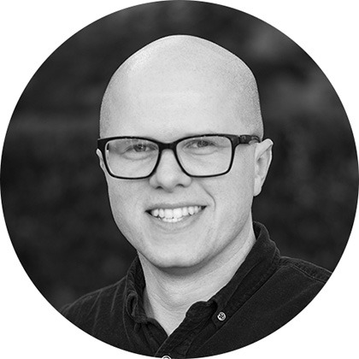
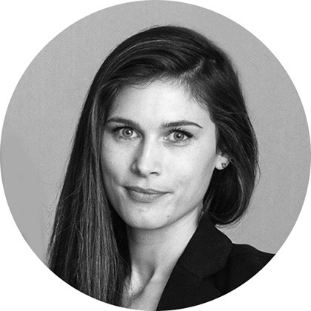
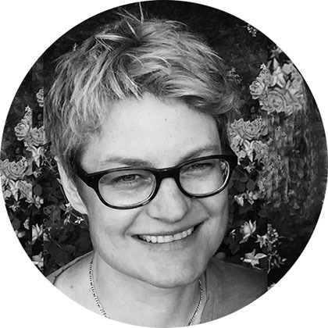
.Your System Flow Coaches.
Eddie Turner
Senior Strategy Lead, Built for Zero Collaborative
Emma Beers
Interventions Manager, Built for Zero Collaborative
Erin Healy
Strategy Lead, Large Scale Change

Slide 7
.On today’s call.
Celebrate fresh reductions
What’s next in the System Flow cohort
Loop back on bucket leads
Practice skills for taking action and orchestrating system-level results
Flex fund updates—on timelines and coaching support
Notes:
Right now, tap into your most focused, nerdy, number loving brain!

Slide 8
If you haven’t calculated this month’s data, take a few minutes to do it now
Notes:
HR

Slide 9
What is one observation you’re making about your data today?
Any trends, outliers, mysterious phenomena?
Chat or unmute
Notes:
HR

Slide 10
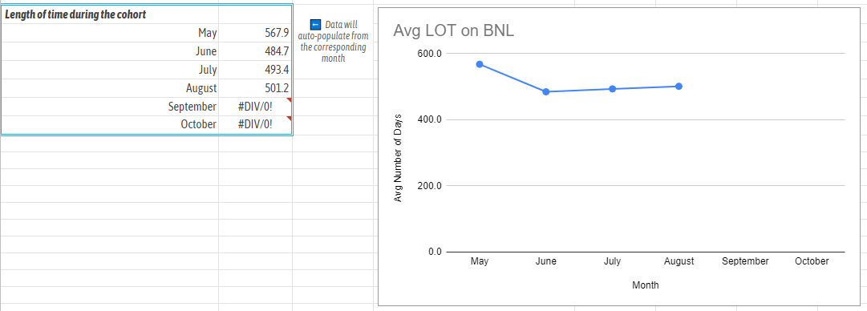
Mid-Willamette Valley
36% reduction in LoS
Notes:
WMV team unmute, what got you there?

Slide 11
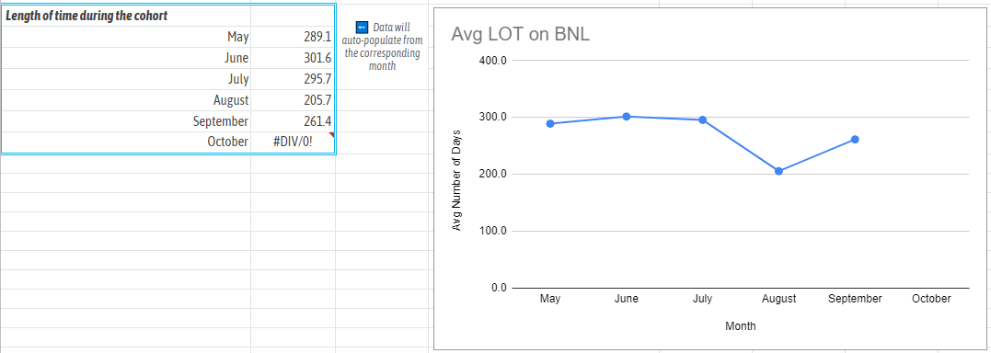
Yamhill County
29% reduction in LoS
Notes:
Yamhill team unmute, what got you there?

Slide 12
System Flow status check.

Slide 13
Who to contact at BFZ.
Eddie and Emma are swapping in to coach the System Flow cohort
Email us anytime:
Eddie Turner eturner@community.solutions
Emma Beers ebeers@community.solutions
Via email, we can troubleshoot problems and provide quick answers
We’re also available for one-on-one calls to break open a problem or facilitate a conversation
Notes:
ET

Slide 14
Let’s finish strong.
This action cycle started at the May 2021 Learning Session
The action cycle ends at the next Learning Session, November 2-3
That means we’ve got about 6 weeks to improve toward our aims
Notes:
ET

Slide 15
Pop Quiz!.

Slide 16
...and then let’s keep going.
In System Flow, you’re uncovering new sector-wide learning about the link between length of time and functional zero
Will you stay with us in System Flow cohort for the next action cycle?
We’re just getting started driving down these length-of-stay numbers
Let’s go for another cycle, make new progress with our bottlenecks, and reach our aims
Notes:
ET

Slide 17
We want to hear from you.
A BFZ coach will reach out to your improvement team in the coming weeks
We’re curious about what you want to accomplish next, your team composition, your feedback and ideas for System Flow, and if staying in this cohort for the next cycle works for you
Notes:
ET

Slide 18
What questions are coming up?

Slide 19
Bucket Leads.
Notes:
EH

Slide 20
After our last call, did you recruit any bucket leads?
Distributing Power
If yes, how did it go?
Ability/time to support person in this role?
Identified new leadership/team member for improvement work ?
If no, what were the main challenges?
In identifying who to ask?
In getting to a yes with someone you asked?
Barriers re: capacity, confidence, or skills

Slide 21
A good process creates good results.

Slide 22
Are you an old-school improvement wiz from Learning Sessions past?
Or is Quality Improvement (QI) a thing you’ve heard about but not spent time digging into— like the return season of “Twin Peaks”?

Slide 23
Model for Improvement.
What are we trying to accomplish?
How will we know a change is an improvement?
What change can we make that will result in improvement?
PLAN
DO
ACT
STUDY
The Model for Improvement was developed by Associates in Process Improvement
and taught to us by the Institute for Healthcare Improvement

Slide 24
A change idea is the blueprint.
Change Idea: A concrete change to an existing process
Ideal for existing processes or infrastructure (as opposed to processes that you are developing for the first time)
Process mapping helps you spot the opportunity for a change
Some changes take lead time to develop; get clear about the amount of effort that will be required

Slide 25
A test of change how you implement.
Test of Change: Trying a change idea in a real-world scenario
Use the PDSA cycle (or PDSA worksheet) to implement your test of change
Start small—small enough that you could test it by Tuesday!
The goal of any test should be to learn; don’t expect perfection on the first go
Learning from tests should drive the next action you take as a team

Slide 26
The PDSA Cycle.
PLAN
What’s the change idea you’ll test?
DO
What action did you take?
STUDY
How did it go?
ACT
What will you do next?
PLAN
DO
ACT
STUDY

Slide 27
How to use PDSAs to get results.
Your System Flow aim is to reduce the length of stay of households on your BNL.
If we knew instantly how to house long-stayers, we’d just take action—
but we’ve got some complex barriers to get through.
Medical acuity
Ineligibility
Prior evictions
Lack of income
Missing documentation
Lack of social support
Substance abuse
High vulnerability
Distrust of system

Slide 28
Now let’s run some tests.

Slide 29
Winston-Salem.
Objective: Reduce the length of time it takes to complete intakes.
Test: Collect as much information need for the intake as possible.
Prediction: Utilizing HMIS can reduce duplicate data collection
What did you learn? [Tell us how it went]
What’s next: [Plan your next test]

Slide 30
Lake County.
Objective: Identify creative housing options to free up PSH
Test: House 2 clients through EHV program
Prediction: Team will develop new muscle for utilizing creative housing options
What did you learn? 1 client has gone through the process of getting onto a move-on voucher, and is identifying a unit - freeing up that spot should allow someone with higher vulnerability to move into the existing PSH slot. Creating a vacancy is half of the solution, and the other half is matching an appropriate household into the unit. The solution isn’t just the vacancy
What’s next: Work earlier to identify housing needs for each client.
Find 2 clients who are next in queue for PSH and do a housing needs assessment on them to see if a household can be matched to new vacancies more quickly. Two impact points: 1) keeping vacancy open shorter time, 2) keeping household homeless for less time.

Slide 31
Middlesex County.
Objective: Reduce the length of time it takes to match with a unit
Test: Use flex funds to pay application fees, etc.
Prediction: Length of stay will reduce
What did you learn? Have not started using funding yet, but have developed protocol for funds. Waiting on final approval from supervisors in order to start testing. Decided to split flex funding 2 ways: give CMs gift cards directly for incentives for engagement, and also have a way to pay more substantial fees associated with navigation. Interested in impact on clients, as well as impact on CM’s self-advocacy/agency. Does seem to encourage CMs so far
What’s next: [Plan your next test]

Slide 32
Let’s head to Mural and plan your next test
Notes:
Link here

Slide 33
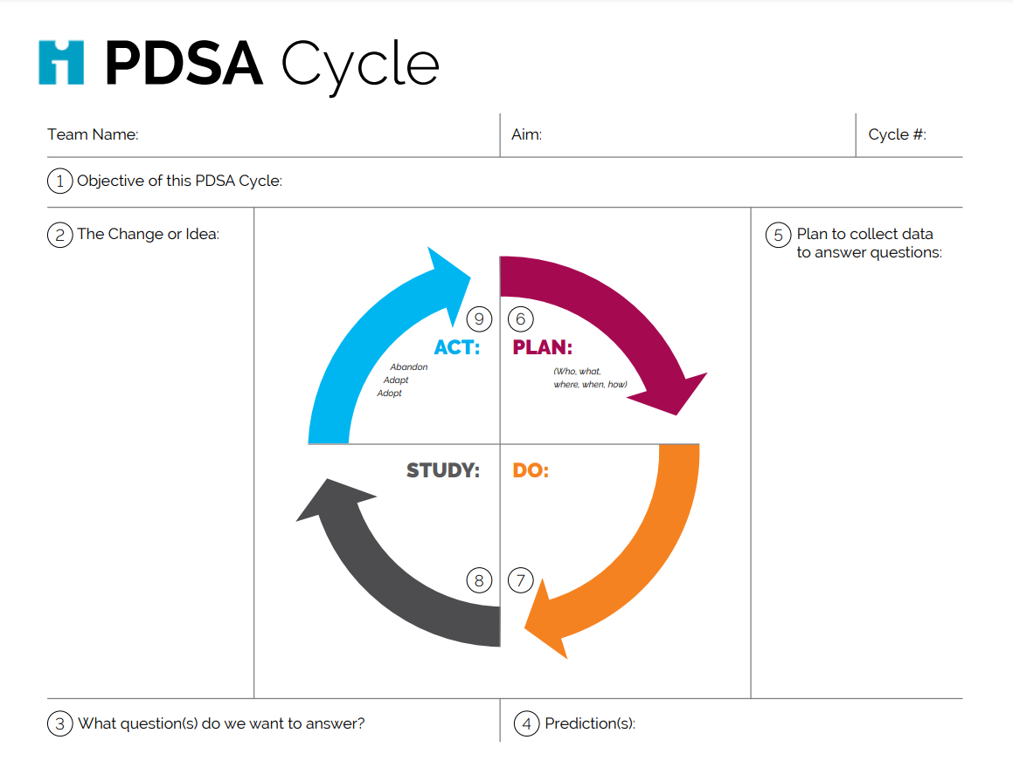
Final step: Fill in a PDSA sheet!.
Notes:
Link here

Slide 34
For the next month....
Notes:
EH

Slide 35
Take action after this call.
Fill in your PDSA worksheet with the idea you added to the Mural before our next call
Report your August data if you haven’t yet
Reach out to a BFZ coach to problem-solve for any stuck points

Slide 36
Flex fund updates: Timing.
It’s not too late to apply if you haven’t yet. Email Eddie: eturner@community.solutions
Like Santa checking his list twice, we’re combing through all the documents
BFZ will reach out in the next week with questions or updates
We’re looking to move any remaining funds in the next two weeks
Notes:
ET

Slide 37
Flex fund updates: Support.
If you are receiving a flex fund...
We’re going to lighten up the reporting requirements; more soon
We’ll gather recipients approx. every 2 months for a small group call to learn together
Spend funds by April 30, 2022—the end of the next action cycle
Notes:
ET

Slide 38
We’ll reach out this month.
We’re glad to be improving with you!
Email us anytime:
Eddie Turner eturner@community.solutions
Emma Beers ebeers@community.solutions
Via email, we can troubleshoot problems and provide quick answers
We’re also available for one-on-one calls to break open a problem or facilitate a conversation
Notes:
ET

