Slide 1
Charlotte/Mecklenburg County CoC
30% Reduction in Veteran Homelessness
January 2020

Slide 2
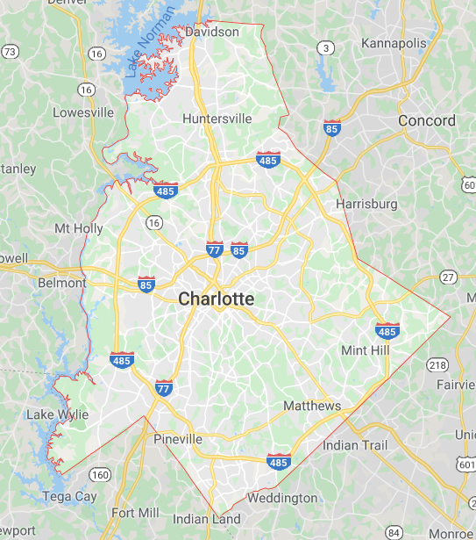
Charlotte/Mecklenburg County CoC
2019 Team
Champion Lead: Mary Gaertner
Team Leads: Janene McGee and Patrick Hayes
Data Lead: Mary Ann Priester
CoC Champion: Mary Gaertner
BFZ System Transformation Advisor: Kally Canfield

Slide 3
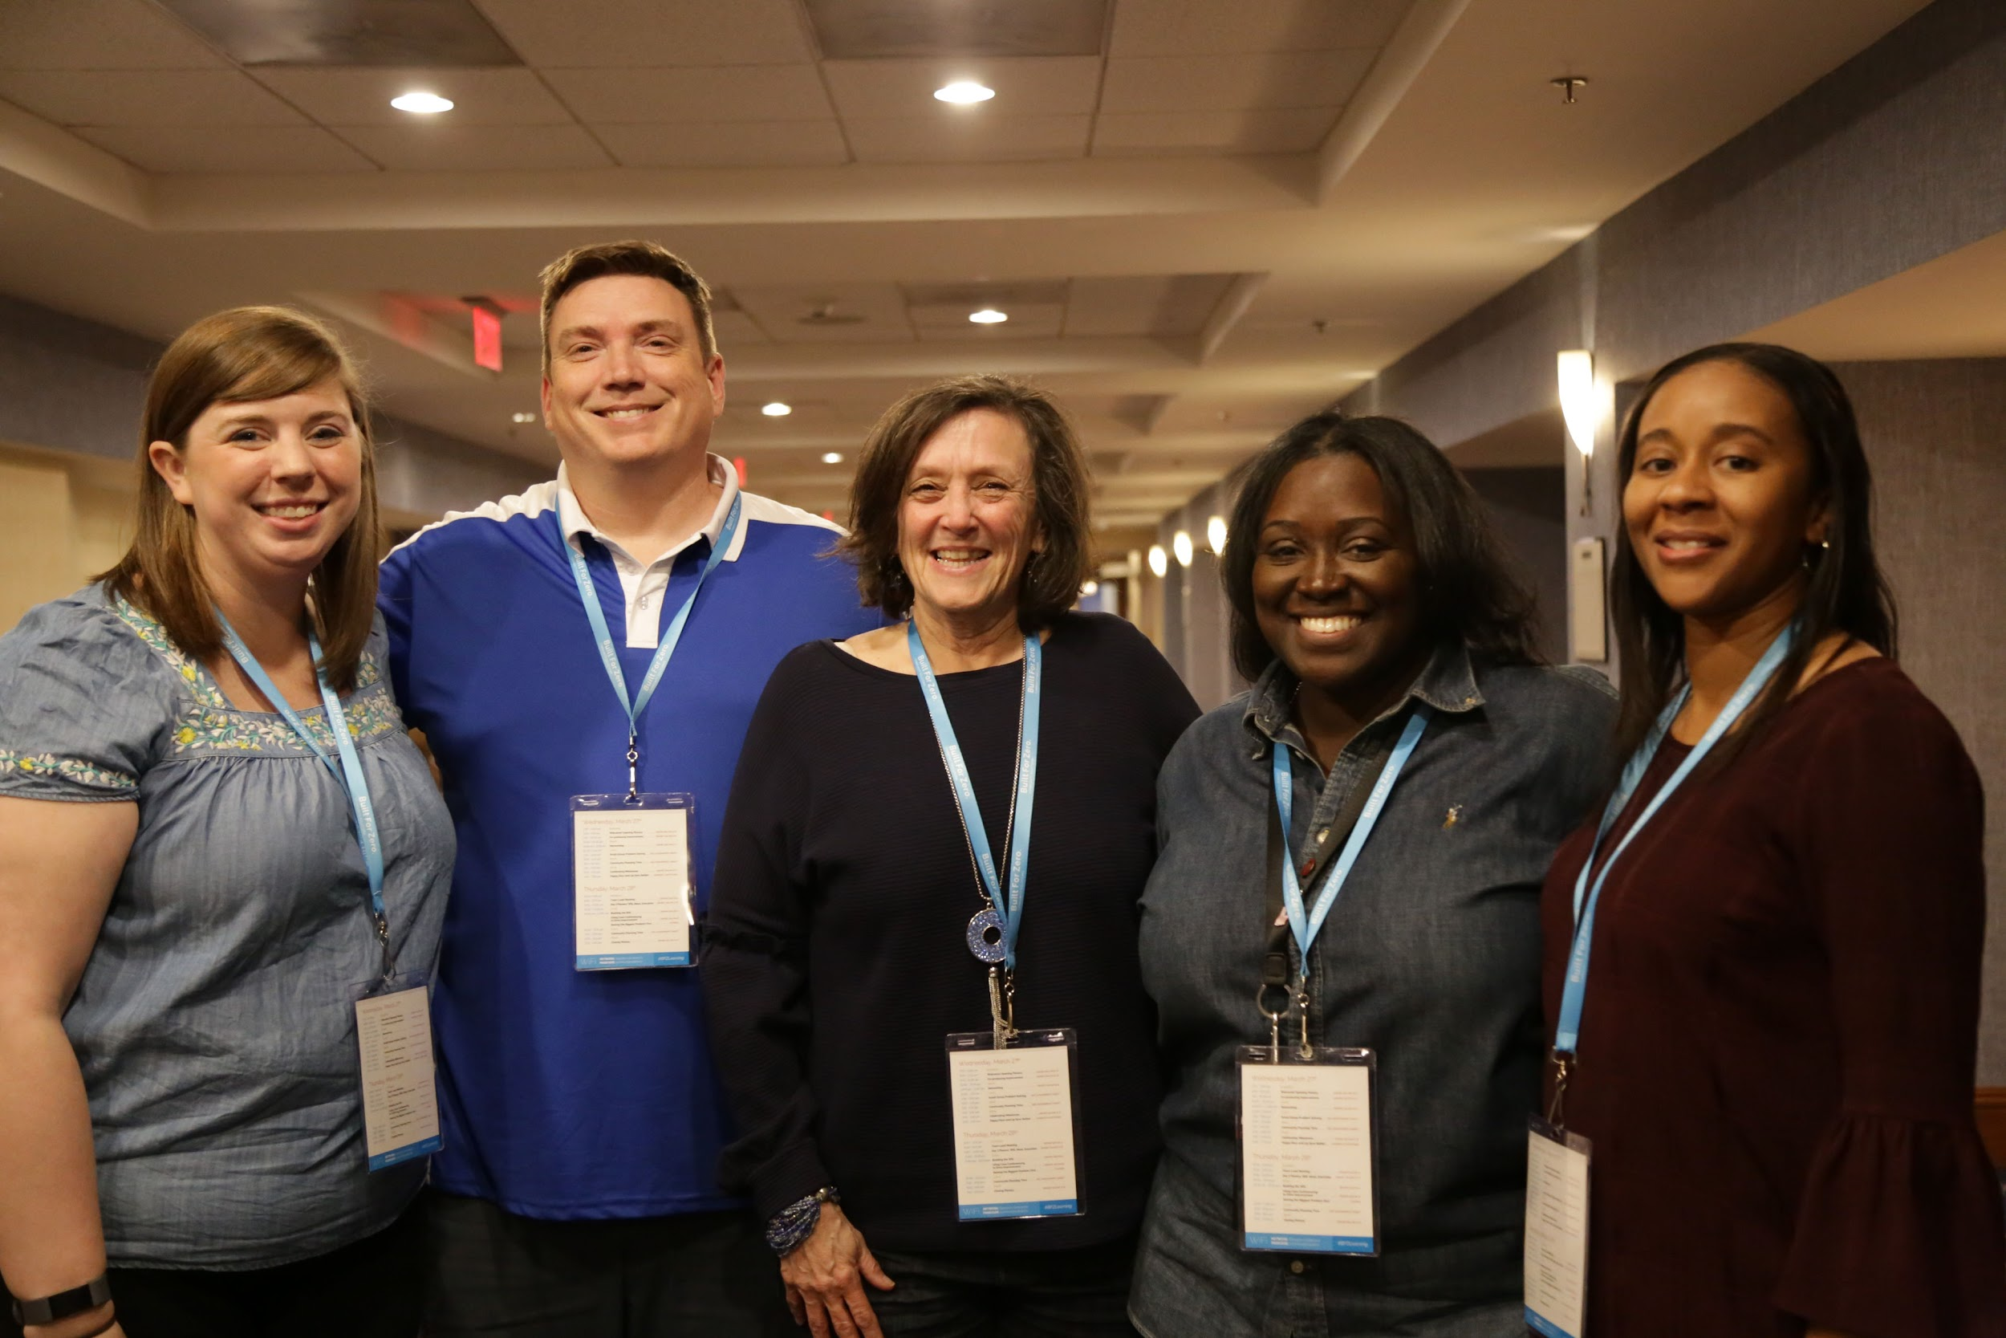
Charlotte/Mecklenburg County CoC

Slide 4
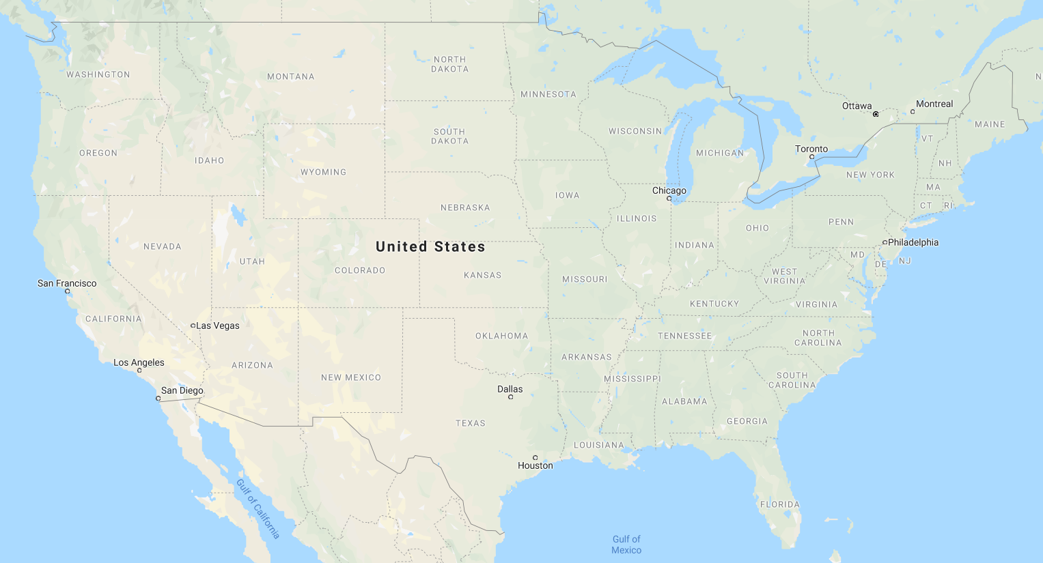
2019 Large City Cohort
Bringing functional zero to scale.
DETROIT
DENVER
ST. LOUIS
D.C.
CHARLOTTE
PHOENIX
JACKSONVILLE

Slide 5
30% Reduction in Actively Homeless Veterans
315
213
Charlotte/Mecklenburg CoC met its reduction goal with a 32% reduction!
# Actively
Homeless Veterans
Dec 2018
# Actively
Homeless Veterans
Dec 2019

Slide 6
CHARLOTTE/MECKLENBURG COUNTY COC:.
JOURNEY TO QUALITY, REAL-TIME DATA.

Slide 7
Timeline
Before Large City Cohort Support
After Large City Cohort Support
Charlotte’s journey to an over 30% reduction in veterans experiencing homelessness.
Charlotte achieves its 30% reduction goal through rapid cycle testing of change ideas and data quality improvements!
Charlotte joins the Built for Zero Large City Cohort and sets a 30% reduction goal
Revitalized and strengthened VA relationship results in dramatic data quality improvements
MAR 2019
JUL 2019
NOV 2019
DEC 2018
JUN 2019
SEP 2019
Charlotte reaches standards for a quality, reliable BNL for the first time!.
Charlotte begins quality improvement work with their System Transformation Advisor
Built for Zero and VA national conduct a front line staff meeting, causing the community to reignite systems improvement work

Slide 8
Defining a Quality By-Name List.
Charlotte/Mecklenburg County CoC met all of the quality and reliability thresholds in Dec 2018.
FULL COVERAGE | All agencies and programs are represented List includes people sleeping in shelters and on the streets
PERSON- LEVEL DATA | Each person has an entry that includes their name, history, health and housing needs Each person can be followed through the system
RELIABILITY | Data balances month over month, just like your checkbook
REGULAR UPDATES | List is updated monthly, at a minimum As people’s housing status changes, so do their list entries
Notes:
A quality by-name list ensures that it is full coverage, it include person-level data (every person can be tracked through the process), the data is reliable meaning that changes in actively homeless numbers are accounted for in inflow and outflow numbers - the dynamics of the system are reliable, and it is regularly updated to ensure data is accurate at any given time. Charlotte has met these quality and reliable by-name list standards for their veteran by-name list.

Slide 9
Qualitatively Assessing your list
Charlotte set a baseline of 9 on the veteran scorecard in Feb 2016. They achieved a perfect score in Dec 2018.
Charlotte/Mecklenburg County CoC reached a perfect score on the veteran scorecard in December 2018 successfully meeting the framework below to produce their veterans by-name list.
COMMUNITY PARTICIPATION & COVERAGE
POLICIES & PROCEDURES
DATA INFRASTRUCTURE
1. Tracking all homeless individuals
2. Inactive policy
3. Tracking homeless status
4. Outreach coverage
8. Tracking without full assessment
6. Unique identifier
5 Providers reporting data
7. Tracking newly identified people
9. Including veterans experiencing chronic homelessness
10. Tracking returns to system
Notes:
Charlotte reached a perfect score on the veterans scorecard in Dec 2018, successfully meeting the required BNL framework to produce their veterans by-name list. This ensures that Charlotte has reached quality data to measure improvements over time. Charlotte set a baseline on the scorecard in February 2016. Being able to check off all of the components of the veteran scorecard is indicative that Charlotte has confidence that their by-name list is comprehensive and therefore capturing every veteran experiencing homelessness within their community.

Slide 10
Key Data Points.
Charlotte/Mecklenburg County CoC is consistently reporting these key data points for
veterans monthly.
INFLOW
ACTIVELY HOMELESS
OUTFLOW
INFLOW:
NEWLY
IDENTIFIED
INFLOW:
RETURNED FROM HOUSING
INFLOW:
RETURNED FROM INACTIVE
OUTFLOW:
HOUSING PLACEMENTS
OUTFLOW:
MOVED TO INACTIVE
OUTFLOW:
NO LONGER MEETS POP CRITERIA
Notes:
These are the key data points that a by-name list should be able to produce in an accurate and reliable way. Charlotte is consistently reporting these key data points for veterans monthly.

Slide 11
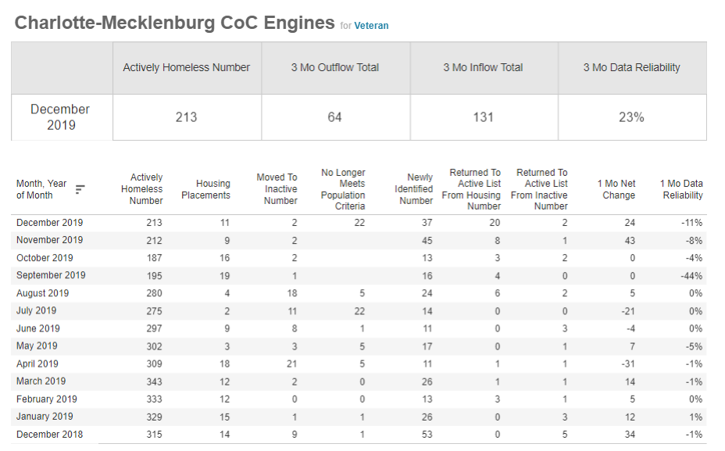
Data Reliability
In Dec 2018, data for Charlotte/Mecklenburg County CoC was near perfectly balanced ( close to 0% data reliability) meaning that changes in actively homeless numbers are accounted for in inflow and outflow. This signalled that data management practices were robust and efficient and that data was being tracked in a consistent manner.

Slide 12
Data Reliability
.Although Charlotte first achieved quality data in Dec 2018, data reliability changed when they implemented new HMIS Inflow/Outflow reports in September of 2019. Their data reliability has since increased after the initial reporting change.

Slide 13
Improving Data Quality - Successful Improvement Projects
Jun ‘19: Quickly verifying veterans status by accessing SQUARES. Predicted Impact: Increase in Outflow - “no longer meets population criteria” and increased data quality.
Community Data Lead given access to SQUARES tool. Ability to bulk search all names on the BNL in SQUARES to accurately verify veteran status with a single search action.
Jul ‘19: Strengthening relationship with VA. Predicted impact: Increase in Inflow - Newly Identified, decrease in length of time homeless, increased data quality.
Joint meeting with community members, Systems Transformation Advisor, and VACO staff to achieve role clarity around data collection/entry responsibility.
Local VAMC committed to hiring CES staff member who was officially hired in Oct ‘19.
Sep ‘19: Re-orient case conferencing around action. Predicted impact: Decrease length of time homeless, Increase in Outflow - Housing Placements, increased data quality.
Up to this point, case conferencing had been focused on ensuring list timeliness and accuracy. With rededicated focus and support from VA staff, conversations could shift from “who should be on the list” to “how can we house the people on the list with the resources we have.”

Slide 14
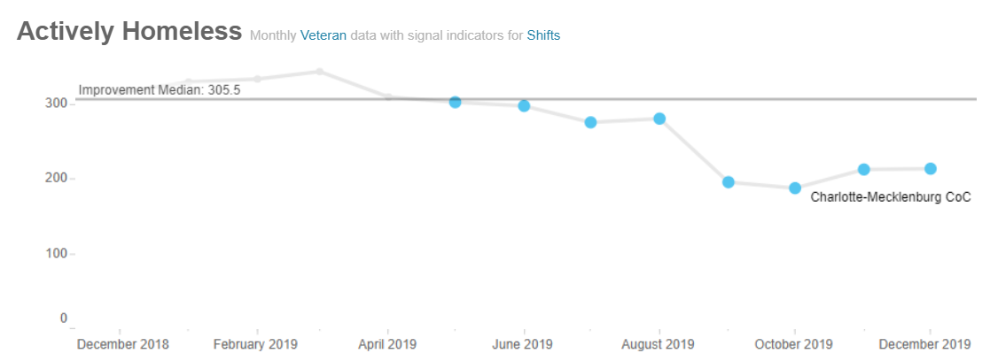
Actively Homeless - Monthly Veteran Data
Sep 2019
BFZ Staff Onsite for Frontline Staff
Implemented new improved inactivity policy
Jun 2019
SQUARES access leads to list clean up
Strengthening VA relationships
Jul 2019
Refined and improved data quality
VA provider accountability for populating BNL

Slide 15
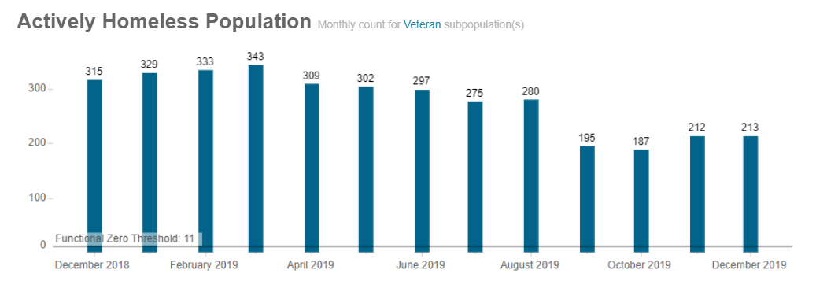
Actively Homeless - Monthly Veteran Count
Nov 2019: Achieved sustainable 30% Reduction Goal!
May 2019: 30% Reduction goal set
30% Reduction Goal

Slide 16
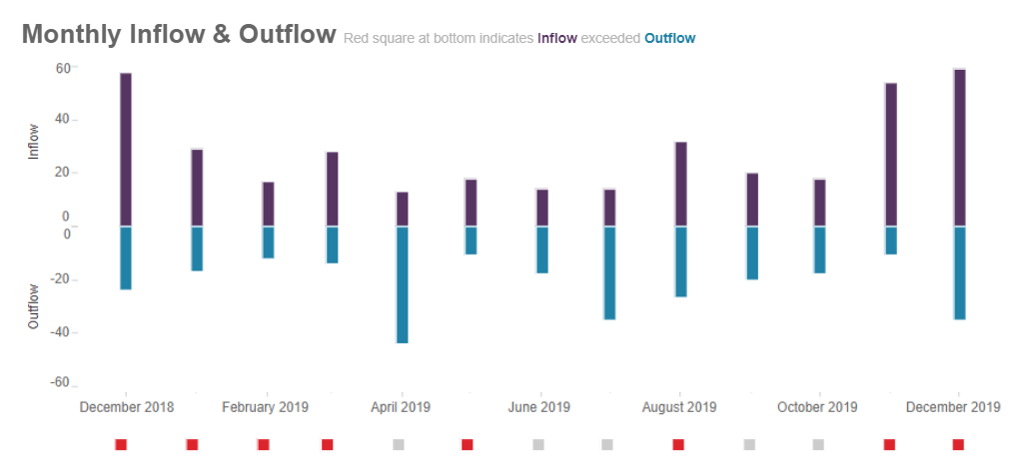
Notes on Inflow:
Charlotte started seeing more inflow in July and August, likely as a result of switching to a more accurate BFZ BNL report.
Inflow numbers spike in November as a result of increased VA participation in CE and the integration of the VA data on to the BNL
2018
New Inflow:
“New Inflow” refers to those people that have been newly identified as being homeless; they haven’t been on the By-Name List before.
The majority of Charlotte’s inflow are New Inflow. This is an indicator of strong outreach and community provider data collaboration.
2018

Slide 17
Notes on Outflow:
Although Charlotte’s outflow decreased over time, its housing placements has actually increased. The decrease in outflow shown here is due to fewer veterans being moved to inactive status.
Notes on data clean up efforts:
Charlotte’s data clean up effort took off in the summer of 2019, wrapping up by September. Now that Charlotte has a reliable way to verify veteran status, they expect to see fewer moves to inactivity.
2018

Slide 18
CHARLOTTE/MECKLENBURG COUNTY COC:..
AIMING TOWARD THE NEXT GOAL.

Slide 19
Key milestones toward ending homelessness
Charlotte/Mecklenburg County CoC is pushing forward with a new goal that will lead them closer to the final milestone: achieving Functional Zero for Veterans!
Build the will among community leaders and develop a shared aim
Achieve a real-time, by-name list of people experiencing homelessness
Drive monthly reductions in your actively homeless number
Achieve a measurable zero in your community
Solidify a system to sustain zero and expand to other populations

Slide 20
Charlotte/Mecklenburg County CoC:
What’s Next?
On January 23, 2020 Charlotte’s community members, VA Staff, and System Transformation Advisor met to set their 2020 reduction AIM. Charlotte is again hoping to reduce veteran homelessness by 30% this year.
Because of increased collaboration with the VA, Charlotte/Mecklenburg County applied for additional HUD-VASH vouchers for the first time in years and were awarded additional VASH vouchers that can be utilized in 2020.
In October of 2019, Charlotte welcomed a new SSVF provider to the community. This additional resource will help house many veterans through Rapid Rehousing that are on Charlotte’s BNL and help the community reach their 2020 reduction goal.
A second iteration of the front line staff meeting will take place in Charlotte March of 2020.

Slide 21
Charlotte/Mecklenburg County CoC:
Improvement Opportunities Ahead
Managing HUD-VASH Resources - making sure all vouchers are utilized, and making plans for deploying additional vouchers.
Improving the Coordinated Entry System - Charlotte was an early adopter of Coordinated Entry, receiving accolades from HUD. As they engage in radical systems change with Built for Zero, they will need to work to grow their Coordinated Entry system alongside it.
Facing relational and policy - related challenges head on, honoring the contributions of everyone at the table, and continuing the momentum toward systems improvement.

Slide 22
Charlotte/Mecklenburg County CoC:
Community Strengths
Invested in relationship-building and long-term strategy.
Continued participation in the Built for Zero Large City cohort and coaching from their Systems Transformation Advisor.
Fired up frontline staff, enthusiasm for improvement work.
Highly engaged VA staff and addition of VA CES staff member adds capacity for data quality and housing improvement work.
Addition of an SSVF provider dedicated to serving Charlotte/Mecklenburg County.

Slide 23
30% Reduction
Congratulations, Charlotte/Mecklenburg CoC!

